Slide 1
SERVLET
Web Programming with Java

Slide 2
Table of Content
In this lecture, we are going to learn:
Java Web Application
Servlet Overview
Environment Setup
Servlet Form
Servlet Filter
Sessions and Cookies
Database connection with JDBC
Localization and Internationalization

Slide 3
Getting Started
Introduction to Java Web Application
Servlet Overview
Environment Setup
Servlet Form
Servlet Filter
Sessions and Cookies
Database connection with JDBC
Localization and Internationalization

Slide 4
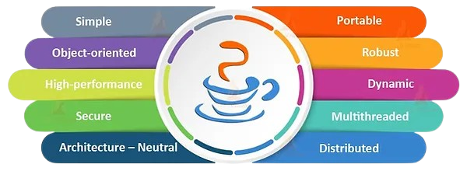
Getting Started
Java, a high-level programming language and computing platform, was introduced by Sun Microsystems in 1995. Since then, it has evolved into a cornerstone of the modern digital landscape, enabling the development of diverse applications and services. It serves as a robust platform for software development, empowering the construction of:
Standalone applications
Web applications
Mobile applications
So much more…
Moreover, with over 3 billion devices running on Java, its relevance and ubiquity are undeniable, cementing its position as a critical technology in today's tech ecosystem.
In this course, we are going to learn how to build a Web application using Java.

Slide 5
Getting Started
Introduction to Java Web Application
Servlet Overview
Environment Setup
Servlet Form
Servlet Filter
Sessions and Cookies
Database connection with JDBC
Localization and Internationalization

Slide 6
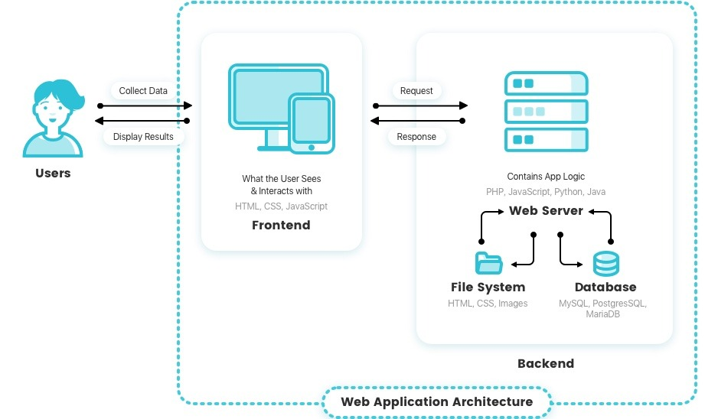
Java Web Application
A web application refers to software accessible through web browsers, consisting of frontend and backend.
The frontend, which is the part of a web application that users interact with directly, is developed using HTML, CSS, and JavaScript, and is supported by most web browsers. On the other hand, the backend, which employs high-level languages such as Java, Python, or PHP, along with databases, is responsible for managing server-side operations in a web application.
Unlike mobile app development, where specific development tools are commonly used, web application development offers developers the flexibility to choose from a variety of Integrated Development Environments (IDEs).

Slide 7
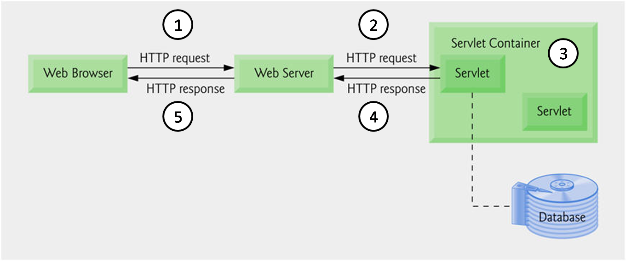
Java Web Application
Java offers several technologies, such as Servlets and JSP, for simplified web application development and server deployment. Also, it provides frameworks, such as Spring Boot, Struts, etc. which streamline the development process, and reduce developers effort.
In this lecture, we are going to learn how to develop a web application using Servlet.

Slide 8
Getting Started
Introduction to Java Web Application
Servlet Overview
Environment Setup
Servlet Form
Servlet Filter
Sessions and Cookies
Database connection with JDBC
Localization and Internationalization

Slide 9
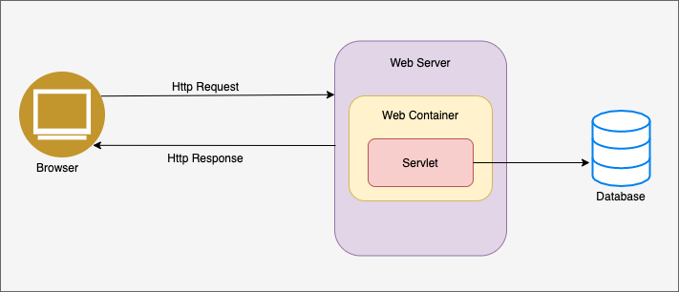
Servlet Overview
In today's digital landscape, the demand for dynamic web pages is ever-growing. Websites must adapt to user interactions, display real-time data, and handle diverse requests efficiently. This necessitates server-side technologies capable of processing requests and generating dynamic content on the fly.
Java Servlet is a pivotal technology essential for fulfilling this demand. They are Java programs designed to run on Java-enabled web servers or application servers.
1
2
3
Servlets play a crucial role in handling incoming requests from web servers, processing these requests, generating dynamic content, and subsequently sending the response back to the web server. This makes them indispensable tools for building robust and interactive web applications.

Slide 10
Servlet Overview
In this section, we are going to discuss about:
What is Servlet?
How Servlet works?
Servlet Architecture
Servlet Life Cycle

Slide 11
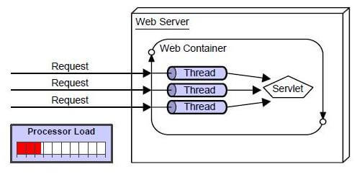
Servlet Overview - Definition
Servlet can be described in many ways, depending on the context.
Servlet is a technology which is used to create a web application.
Servlet is an API that provides many interfaces and classes including documentation.
Servlet is an interface that must be implemented for creating any Servlet.
Servlet is a class that extends the capabilities of the servers and responds to the incoming requests. It can respond to any requests.
Servlet is a web component that is deployed on the server to create a dynamic web page.
In sum, Servlets are Java programs that work on server side and are able to handle complex requests obtained from the web server.
Servlets are under the control of another Java application called a Servlet Container. When an application running in a web server receives a request, the Server hands the request to the Servlet Container – which in turn passes it to the target Servlet.

Slide 12
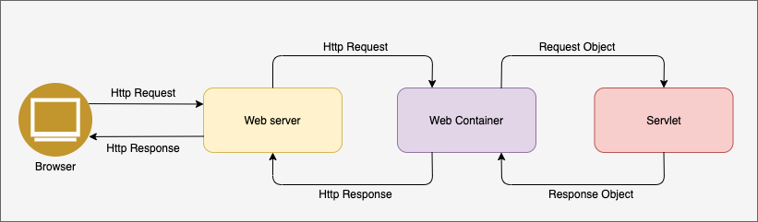
Servlet Overview – How Servlet works?
2
4
1
3
1. A user sends an HTTP request to a web server.
2. The web server forwards the request to the web container (servlet container).
3. The web container checks whether the servlet is in the container, and if not, creates a new servlet.
4. The container also creates HttpServletRequest and HttpServletResponse objects for requests and responses and passes them to the servlet.

Slide 13
Servlet Overview – How Servlet works?
2
4
1
3
8
7
5
6
5. Call service() in the servlet and execute doGet() or doPost().
6. When the service is completed, a response (HttpServletResponse) is returned.
7. The web container changes the response value to fit the HTTP format and sends it to the web server.
8. The web server sends an HTTP response value to the requesting client.

Slide 14
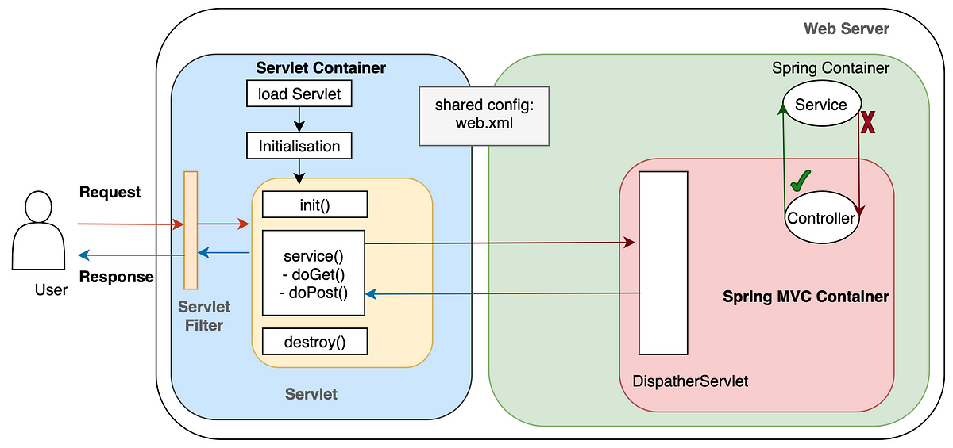
Servlet Overview – Servlet Architecture
Servlet Container: The Home of Servlets
The servlet container, or servlet engine, is the runtime environment that hosts servlets and manages their lifecycle. Servlet containers play a pivotal role in the execution of Java servlets. Key aspects of servlet containers include:
Lifecycle Management: The container initializes, instantiates, and manages the lifecycle of servlets.
Request Handling: Servlet containers handle incoming HTTP requests and dispatch them to the appropriate servlets.
Thread Pooling: Manages a pool of threads to handle multiple requests concurrently.
Web Application Deployment: Loads and deploys web applications, making servlets accessible via specific URLs.

Slide 15
Servlet Overview – Servlet Architecture
Key Characteristics of Servlets:
Request Handling: Servlets process HTTP requests and generate responses dynamically.
Lifecycle Methods: Defined methods (e.g., init, service, destroy) govern the lifecycle of a servlet.
Thread Safety: Servlets are thread-safe, handling multiple requests concurrently.
Server-Side Logic: Ideal for implementing server-side logic, such as data processing, authentication, and more.

Slide 16
Servlet Overview – Servlet Life Cycle
The simple life cycle of Servlet:
When a client request comes in, it checks whether the servlet is in memory. If it does not exist, call init() and load it into memory. If the servlet changes during execution, the existing servlet is destroyed and new contents are loaded back into memory using init().
After init(), the response branches to doGet() or doPost() through the service() method depending on the client request. HttpServletRequest and HttpServletResponse objects created in the servlet container are provided.
When the container requests the servlet to terminate, the destroy() method is called. It runs only once, and anything that needs to be processed upon termination can be overridden with destroy().

Slide 17
Servlet Overview – Servlet Life Cycle
Let’s dive deeper into the set of methods which define the lifecycle of a Servlet:
1. The init method is designed to be called only once. If an instance of the servlet does not exist, the web container:
Loads the servlet class
Creates an instance of the servlet class
Initializes it by calling the init method
The init method must complete successfully before the servlet can receive any requests. The servlet container cannot place the servlet into service if the init method either throws a ServletException or does not return within a time period defined by the Web server.

Slide 18
Servlet Overview – Servlet Life Cycle
Let’s dive deeper into the set of methods which define the lifecycle of a Servlet:
2. The service method is only called after the servlet’s init() method has completed successfully.
The Container calls the service() method to handle requests coming from the client, interprets the HTTP request type (GET, POST, PUT, DELETE, etc.) and calls doGet, doPost, doPut, doDelete, etc. methods as appropriate.
3. The destroy method is called by the Container to take the Servlet out of service.
This method is only called once all threads within the servlet’s service method have exited or after a timeout period has passed. After the container calls this method, it will not call the service method again on the Servlet.

Slide 19
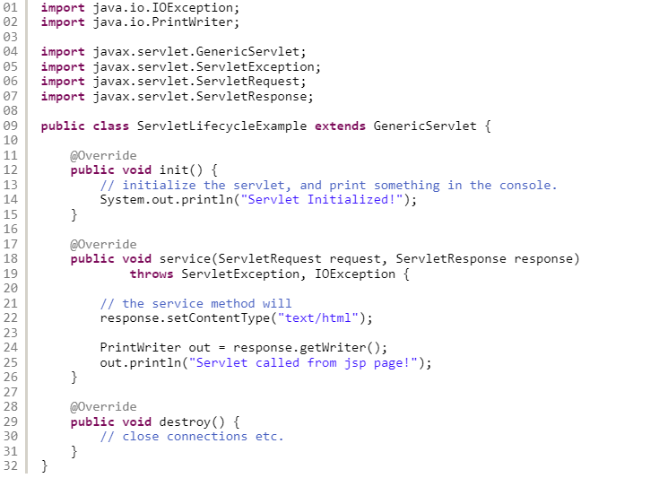
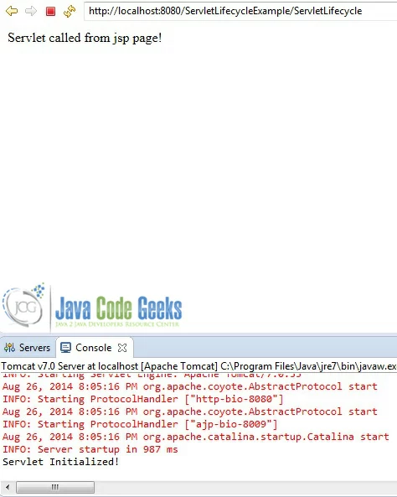
Servlet Overview – Servlet Life Cycle

Slide 20
Getting Started
Introduction to Java Web Application
Servlet Overview
Environment Setup
Servlet Form
Servlet Filter
Sessions and Cookies
Database connection with JDBC
Localization and Internationalization

Slide 21
Environment Setup
Like any other Java program, to create a Servlet, we need to get a development environment.
In this course, we need to install:
Java Development Kit (JDK) – Latest version
Java Runtime Environment (JRE) – Latest version
Apache Tomcat
Eclipse IDE – Latest version for Web Developer
Git GUI

Slide 22
Environment Setup – Hello World
After installing all required tools, let’s test the Servlet by printing “Hello world!” then push the source code to your remote repo.

Slide 23
Getting Started
Introduction to Java Web Application
Servlet Overview
Environment Setup
Servlet Form
Servlet Filter
Sessions and Cookies
Database connection with JDBC
Localization and Internationalization

Slide 24

Thank You
For Your Attention!

